Slide 1
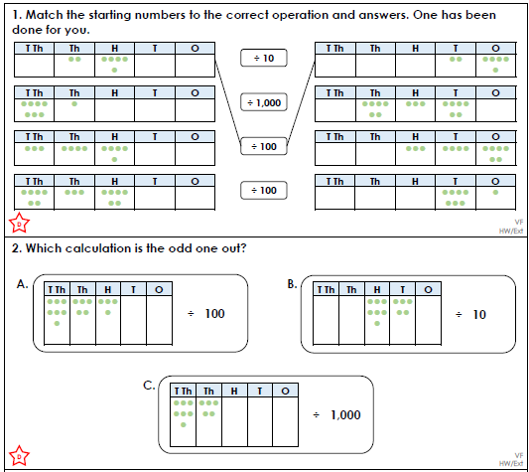
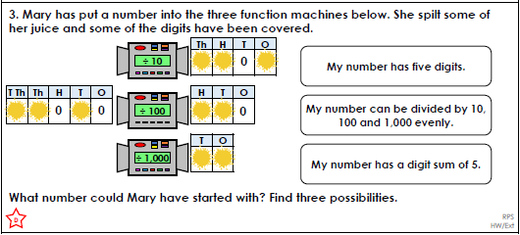
Maths Homework Y5 Mr Masingiri Date set: 13/01/22 Date due: 17/01/22 You need to complete both sections
Section 1 –
Round 264,593 to the nearest 10, 100, 1 000 and 10 000
2. 6 x 4 = ___ x 3 = 12 x ___
3986 x 7 = ________
I am thinking of a number. After I multiply it by 8 and subtract 20 I have 140.
Use the inverse to work out my starting number.
5. 57,345 + 8, 239 + 3,067 =
1
2.
3

Slide 2
Maths Homework Y5 Mr Masingiri Date set: 13/01/22 Date due: 17/01/22 You need to complete both sections
Section 1 –
Round 264,593 to the nearest 10, 100, 1 000 and 10 000
2. 6 x 4 = ___ x 3 = 12 x ___
3986 x 7 = ________
I am thinking of a number. After I multiply it by 8 and subtract 20 I have 140.
Use the inverse to work out my starting number.
5. 57,345 + 8, 239 + 3,067 =
1
2.
3

