Slide 1
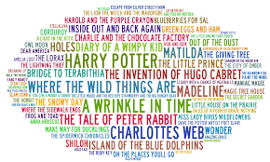
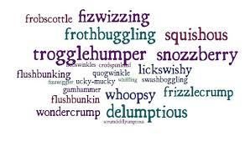
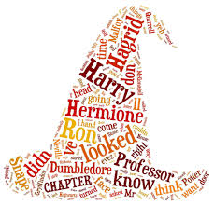
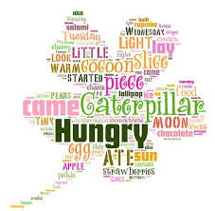
Can you make a word cloud based on a book you have read?
Choose as many key words from the book as you can. Create an image using these words. You can either use a word cloud generator on the computer or do one by hand!

Slide 2
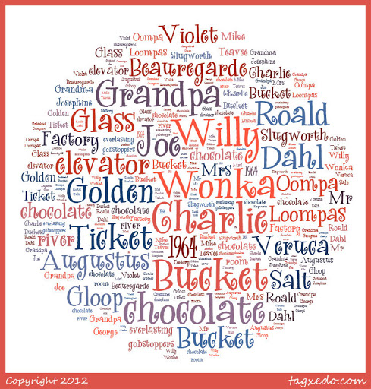
Word Cloud Generators
https://monkeylearn.com/word-cloud/
https://worditout.com/word-cloud/create
https://www.wordclouds.co.uk/
http://wordcloudmaker.com/
There are lots more generators out there too! You may have one you know and use already!

