Slide 1
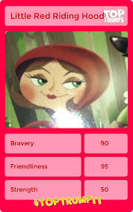
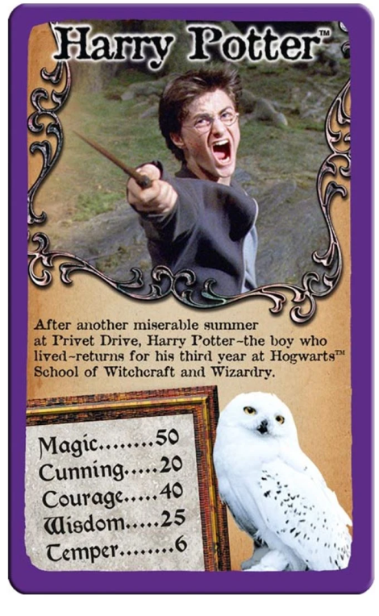
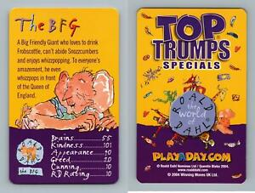
Top Trumps
Can you make some Top Trump Cards based on Children’s Books or Children’s Book Characters?

Slide 2
