Slide 1
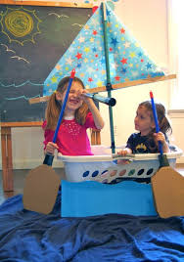
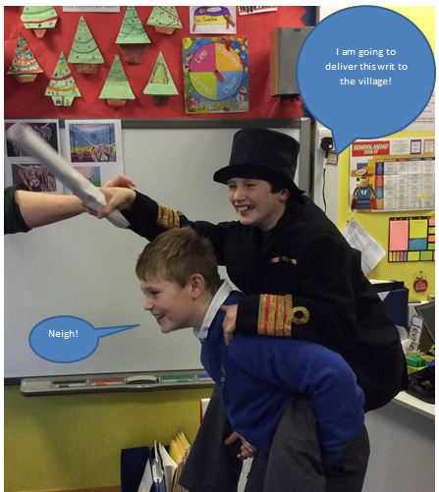
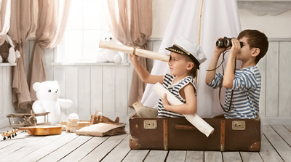
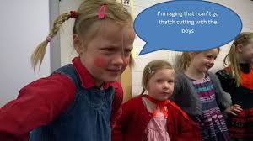
Photo Stills with Captions
Could you set up a photo still with a caption that shows a scene from a children’s book?
You could ask your family to help or use any toys or dolls or characters to set a scene!
Add a speech or thought bubble!

