Slide 1
Could you write a script?
Choose a scene from a book.
Imagine you are going to write a play for this scene.
Think about:
a character list
the setting
action directions
script layout

Slide 2
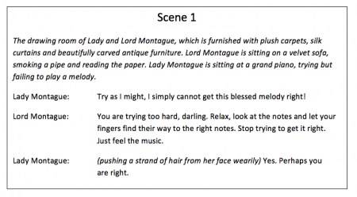
A simple scene from “Romeo and Juliet”

