Slide 1
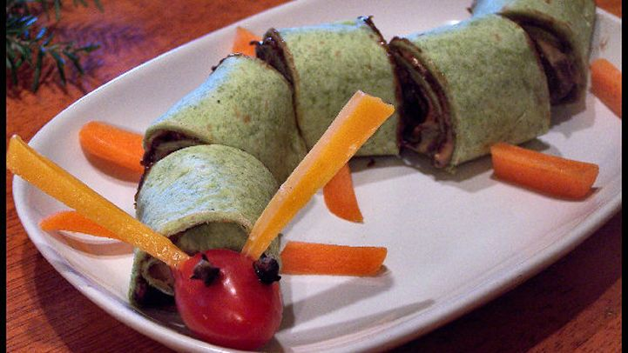
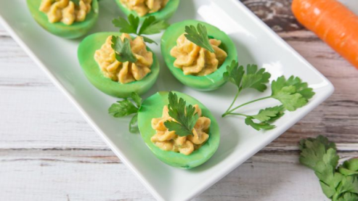
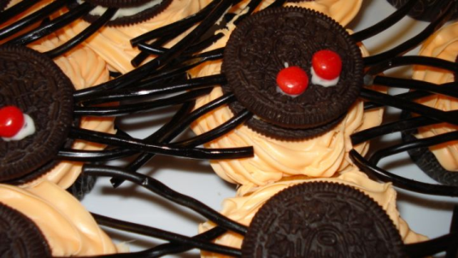
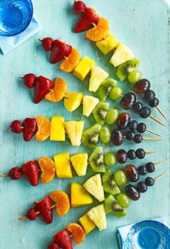
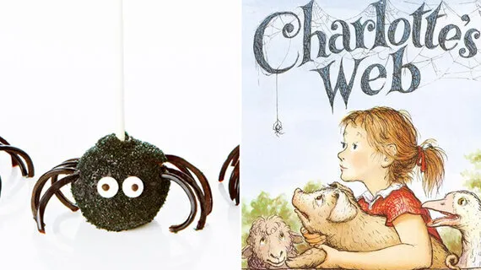
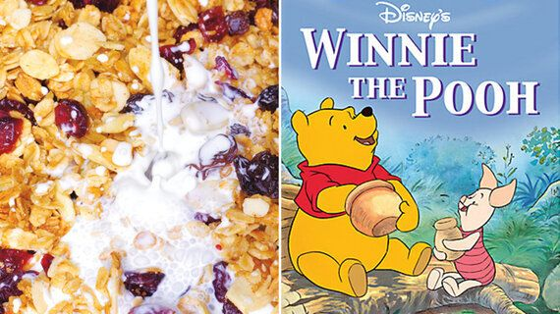
Cooking Inspired by Books
Could you produce a dish that is inspired by a book you have read?
The Twits – worm spaghetti
Rainbow Fruit Kebabs – Rainbow Fish
Honey Pooh Bear dishes
Green Eggs and Ham

