Slide 1
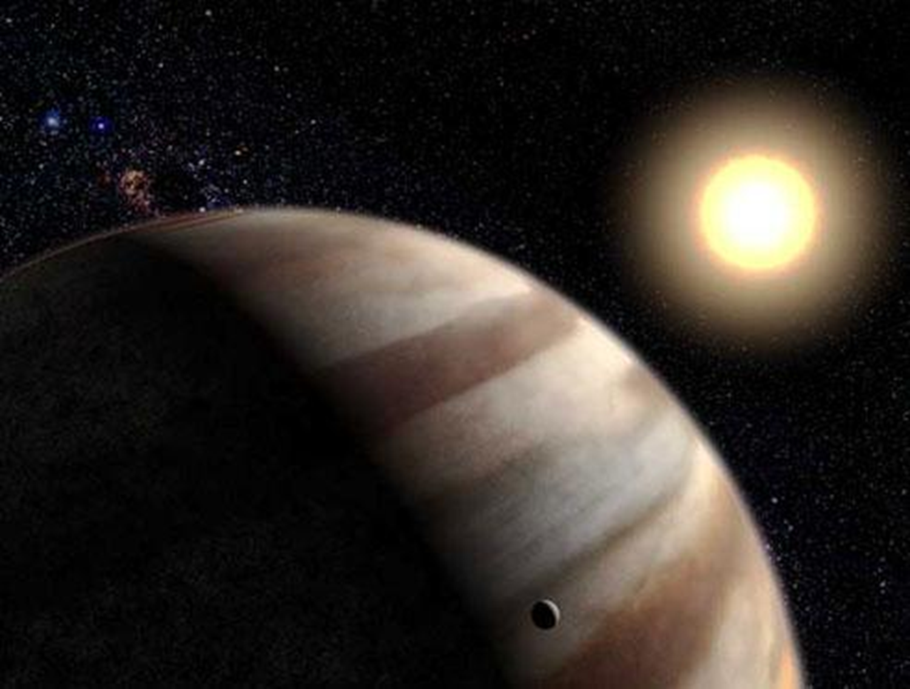
Gustav Holst and The Planets
The Planets Suite
(Week 6)
Gustav Holst
1874 - 1934

Slide 2

Week 6 – Jupiter
(Gustav Holst, The Planets Suite)
This week (Week 6), we will listen to ‘Jupiter’ from ‘The Planets Suite’ (by Gustav Holst).
Slides 3-13 provide information about the life of Gustav Holst. If you have read this already, go straight to Slide 14.
Slides 14-20 provide information about the ‘Jupiter’ movement.

Slide 3
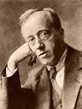
Learning about a famous composer’s life
Gustav Holst was an English composer and music teacher for over 20 years.
Most of the music he composed was original, but he had influences from Hindu spiritualism and English folk tunes.

Slide 4
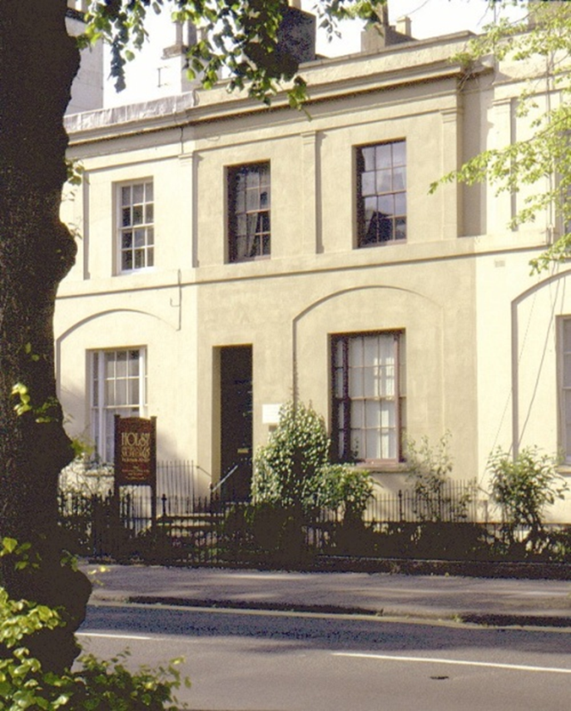
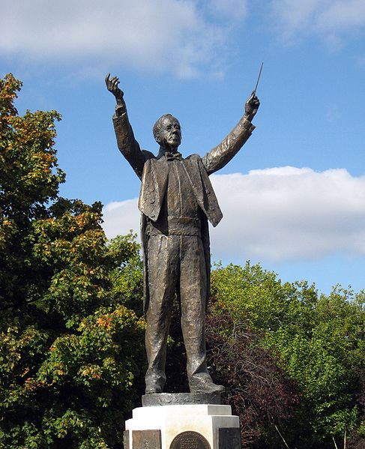

Learning about a famous composer’s life
Gustav Holst was born in Cheltenham, England on the 21st September 1874.
Statue of Holst in his home town.

Slide 5
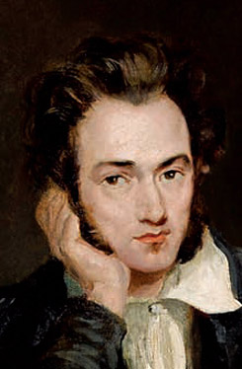
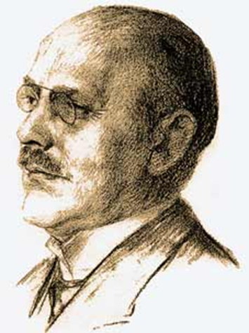
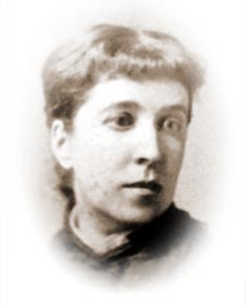
Learning about a famous composer’s life
Holst was born into a very musical family. His grandfather was a harp composer and teacher; his father was an organist, pianist and choirmaster, and his mother was a singer.
Clara Holst
Gustavus von Holst
Adolf Holst

Slide 6
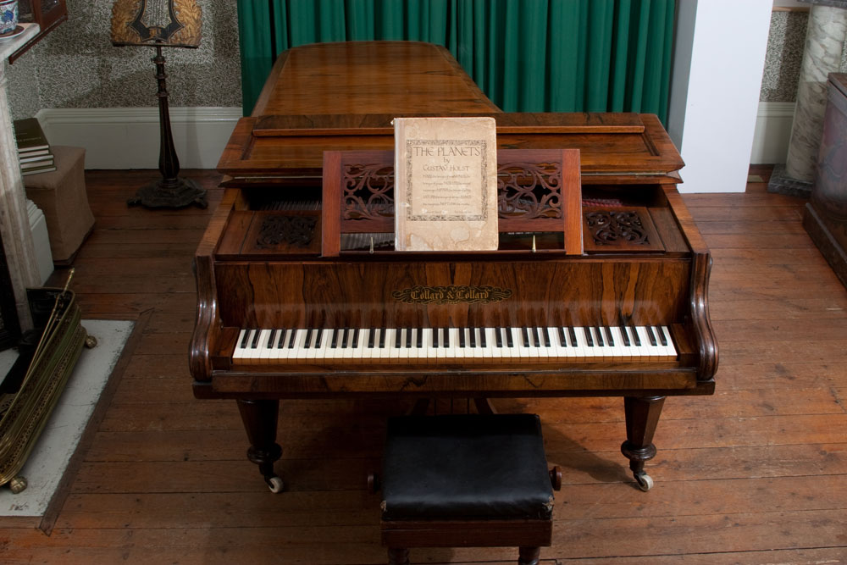
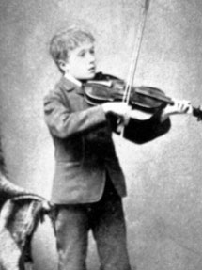
Learning about a famous composer’s life
As a child, Gustav was taught the piano and violin.
This is Holst playing the violin.
This is Holst’s piano. You can see it in the Holst Birthplace Museum. He composed The Planets on this piano.

Slide 7
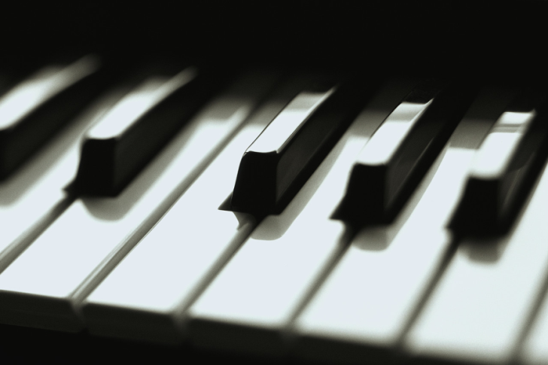
Learning about a famous composer’s life
Gustav was a sickly child. His eyes were weak, but no-one realised that he needed to wear glasses.
His chest was weak and he suffered from asthma.
When he was young, Gustav hated playing the violin, but enjoyed playing the piano.

Slide 8
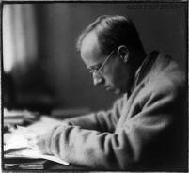
Learning about a famous composer’s life
Unfortunately, Holst also had pain in his hands, so it made practising the piano very difficult and painful.
After leaving school, he got his first job as an organist and choirmaster.

Slide 9
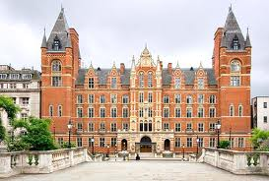
Learning about a famous composer’s life
He became a student at the Royal College of Music, where he studied composition.
Unfortunately, the pain in his right hand became worse. Playing for a long time was impossible and he had to accept that he would never be a professional concert pianist.

Slide 10
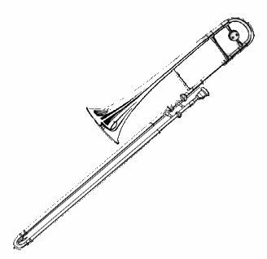
Learning about a famous composer’s life
Holst decided to take up the trombone. It would allow him to play in orchestras, and he could earn some money. Also, the experience would be useful to him as a composer. Perhaps, he also thought that playing the trombone would help to strengthen his chest and lungs.

Slide 11
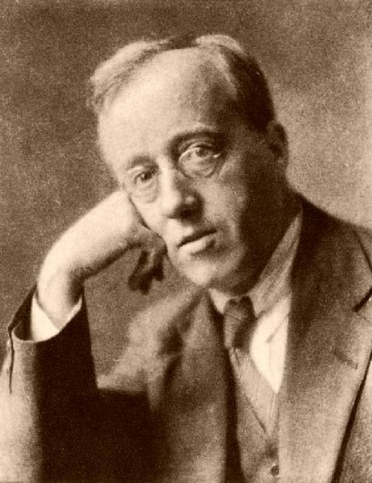
Learning about a famous composer’s life
Holst wrote The Planets Suite between 1914 and 1916.
Each of the seven movements is named after a planet of the Solar System and its corresponding astrological character.

Slide 12
Learning about a famous composer’s life
1. Mars - the Bringer of War
2. Venus - the Bringer of Peace
3. Mercury - the Winged Messenger
4. Jupiter - the Bringer of Jollity
5. Saturn - the Bringer of Old Age
6. Uranus - the Magician
7. Neptune - the Mystic

Slide 13
Learning about a famous composer’s life
Holst did not compose a piece of music about Pluto, as Pluto was not discovered until 1930.
Colin Matthews, a recent composer created a piece of music called Pluto: the Renewer. This is sometimes played alongside Holst’s Planet Suite in concerts. https://www.youtube.com/watch?v=W3Mcn3zo5C0

Slide 14
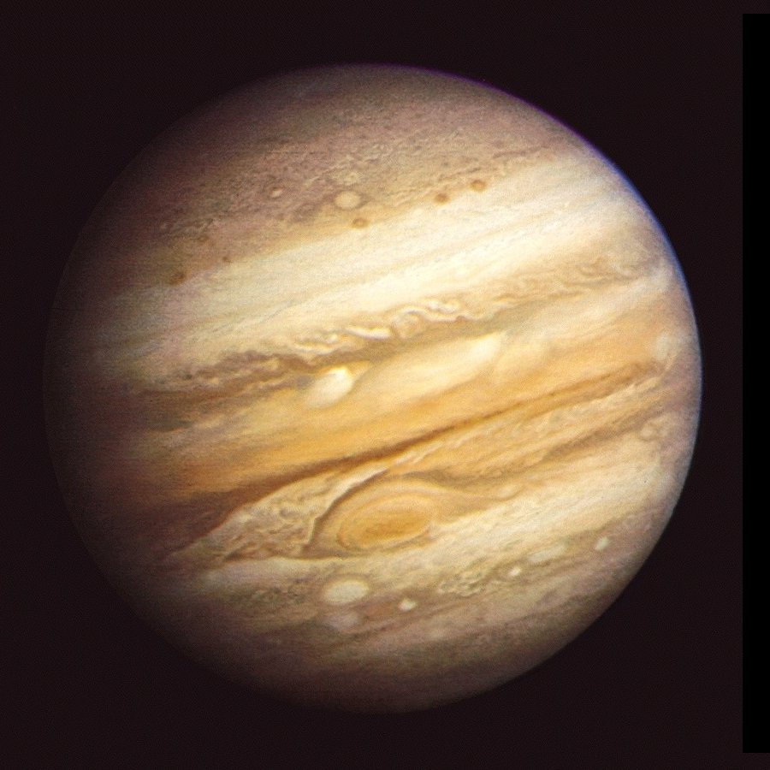
Jupiter
The Bringer of Jollity
(Week 6)

Slide 15
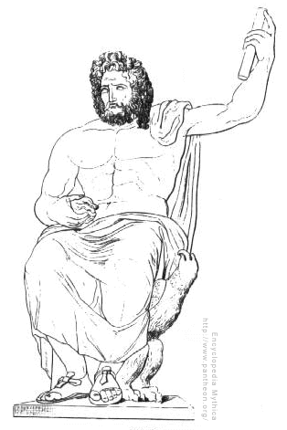
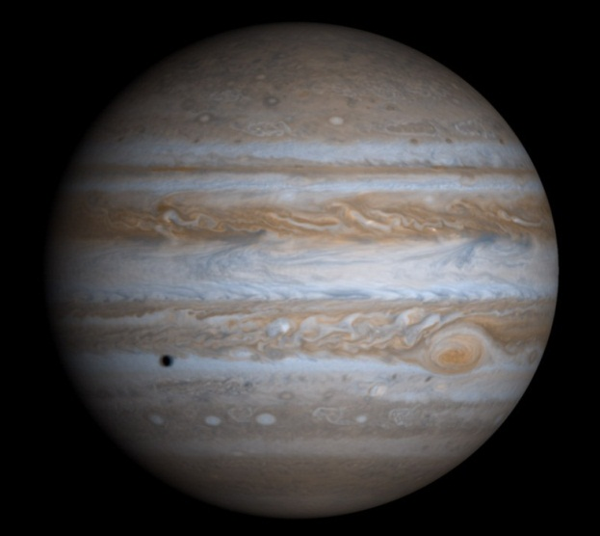
Learning about a song based on
Gustav Holst’s Jupiter
In Roman mythology, Jupiter was the king of heaven and Earth, and of all the Olympian gods.

Slide 16
Learning about a song based on
Gustav Holst’s Jupiter
Watch video clip: Watch Jupiter here
While you listen, draw a picture of how the music makes you feel.
If you would like to, use the separate “Recording Sheet” to write about this music in detail.

Slide 17
Learning about a song based on
Gustav Holst’s Jupiter
The music to Jupiter (The Bringer of Jollity) has been used many times in recent English history.
In 1921, it was used as the tune to a very famous English poem (by Sir Cecil Spring Rice), ‘I vow to thee my country’, which is now what it is most well-known for. Christians often sing it as a hymn in church.

Slide 18
Learning about a song based on Gustav Holst’s Jupiter
In 1921, Gustav Holst adapted the music from a section of Jupiter to create a setting for this poem (by Sir Cecil Spring Rice). The music was extended slightly to fit the final two lines of the first verse.
I vow to thee, my country, all earthly things above,
Entire and whole and perfect, the service of my love;
The love that asks no question, the love that stands the test,
That lays upon the altar the dearest and the best;
The love that never falters, the love that pays the price,
The love that makes undaunted the final sacrifice.
And there's another country, I've heard of long ago,
Most dear to them that love her, most great to them that know;
We may not count her armies, we may not see her King;
Her fortress is a faithful heart, her pride is suffering;
And soul by soul and silently her shining bounds increase,
And her ways are ways of gentleness, and all her paths are peace.

Slide 19
Learning about a song based on
Gustav Holst’s Jupiter
‘I vow to thee my country’ was sung at the wedding of Prince Charles and Princess Diana in 1982.
This hymn was also sung at Princess Diana’s funeral in 1997.
https://www.youtube.com/watch?v=LmeQ_M7fPMw

Slide 20
Learning about a song based on
Gustav Holst’s Jupiter
The music to Jupiter is also used for the ‘World in Union’ (lyrics by Charlie Skarbek), the theme to the Rugby World Cup.
The music has a very royal and patriotic feel, which is why it was chosen for this purpose.
    There’s a dream, I feel, so rare, so real
    All the world in union, the world as one
    Gathering together, one mind, one heart
    Every creed, every colour, once joined, never apart
    Searching for the best in me, I will find what I can be
    If I win, lose or draw, there’s a winner in us all...
Listen to ‘The World in Union’:
Which of the human values does ‘The World in Union’ remind you of?
  https://www.youtube.com/watch?v=xY24sAfIzXo

