Slide 1
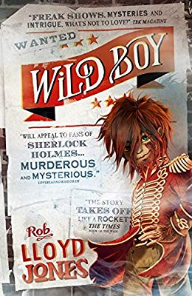
Wednesday 13th January 2021
Wild Boy
Prologue: Pages 7-10
https://www.lovereading4kids.co.uk/extract/9408/Wild-Boy-by-Rob-Lloyd-Jones.html

Slide 2
Where is the story set?
PROLOGUE
SOUTHWARK, LONDON, MAY 1838
That night, the night the showman came, the moon was the colour of mud. Above the houses the sky turned from black to dingy brown as a thick fog crept over the city.

Slide 3
Who arrived at the door?
The monstrous mud-brown cloud rose from the river. It slithered over rooftops, curled around gas lamps and smothered their lights to ghostly orange globes. It crawled along the riverbank, swallowing the warehouses, workhouses and tumbledown tarry-black houses that leaned over the dark water. Doors were bolted. Shutters slammed. Even the rats in the alleys froze in fright as the cloud came rolling in. The fog swallowed everything – but not the showman. His gloved fist banged on the workhouse door. No reply. He banged again.

Slide 4
Who does he say he is there for?
There came a clunk, a thunk. A hatch in the door slid open and bloodshot eyes glared through. “Who the devil are you?” demanded a voice. “I’m here for the boy,” said the showman. The eyes in the hatch narrowed. “What boy? There are dozens of boys.”

Slide 5
What is the name of the master?
The showman leaned forward, revealing his face in the shadow of his crooked top hat. It was a terrible face, ridged with so many scars he looked like he’d been sewn together from patches of skin. There were whip marks, knife cuts and scratches from nails. There were bite marks and burn marks and cuts from a saw. One long gash ran like purple warpaint over his bony nose. He stroked it with a finger as he leaned to the hatch and spoke in a growl. “The boy,” he said. The bloodshot eyes widened. “Oh! The boy. One moment…” Another thunk. Another clunk. The door swung open, revealing the owner of the bloodshot eyes – a plump, greasy individual who had been in the process of devouring a roast chicken. He wore the bird like a glove puppet, one hand inserted into its neck cavity so he could bite chucks from whichever part he pleased. Nibbling on a scab of skin, he eyed the showman warily. “My name’s Bledlow,” he said. “I’m the master of this place.” The showman didn’t reply.

Slide 6
What do the other children call the boy?
The Master swallowed the skin. “You got the money?” “Not till I seen the boy.” Composing himself, Master Bledlow unhooked an oil lamp from the wall. “Follow me,” he said. He led the way down a dark and dingy corridor. Cockroaches scurried into cracks. Damp glistened on bare walls. In a hall, a dozen boys in ragged gowns sat slurping bowls of gruel. One of the boys saw the showman, and grinned wolfishly. “He’s here to see the monster!” he whispered. “Mon-ster!” the others chimed. “Mon-ster! Mon-ster!”

Slide 7
Why does the master say he’s locked the boy up?
With a flick of his arm, Bledlow sent his chicken carcass flying into the hall. Several boys pounced on it, snarling at one another. “Mon-ster! Mon-ster!” the others chanted. The Master raised his light, and led the showman up a rickety flight of stairs. At the top was a wooden door with a warning scratched in charcoal. WILD ANIMAL! BEWARE! The Master glanced at the showman. “We keep him in here. On account of the fighting.” “Fighting?” “Because of how he looks.”

Slide 8
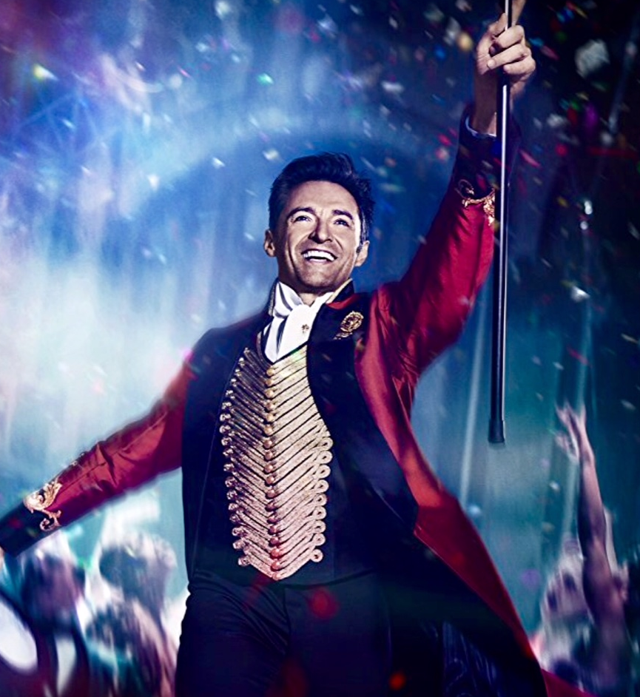
Vocabulary check
showman
The fog swallowed everything – but not the showman. His gloved fist banged on the workhouse door.
This Photo by Unknown Author is licensed under CC BY-NC

Slide 9
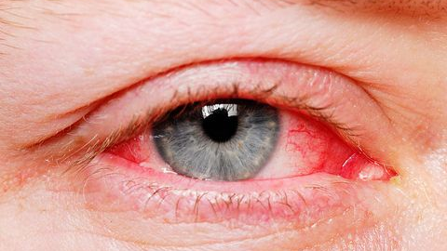
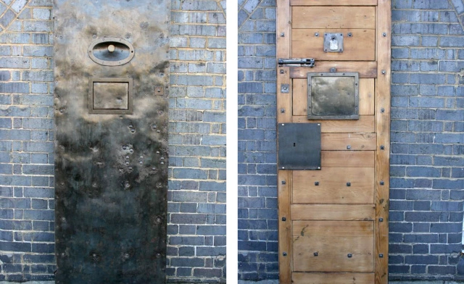
hatch
bloodshot eyes
A hatch in the door slid open and bloodshot eyes glared through

Slide 10
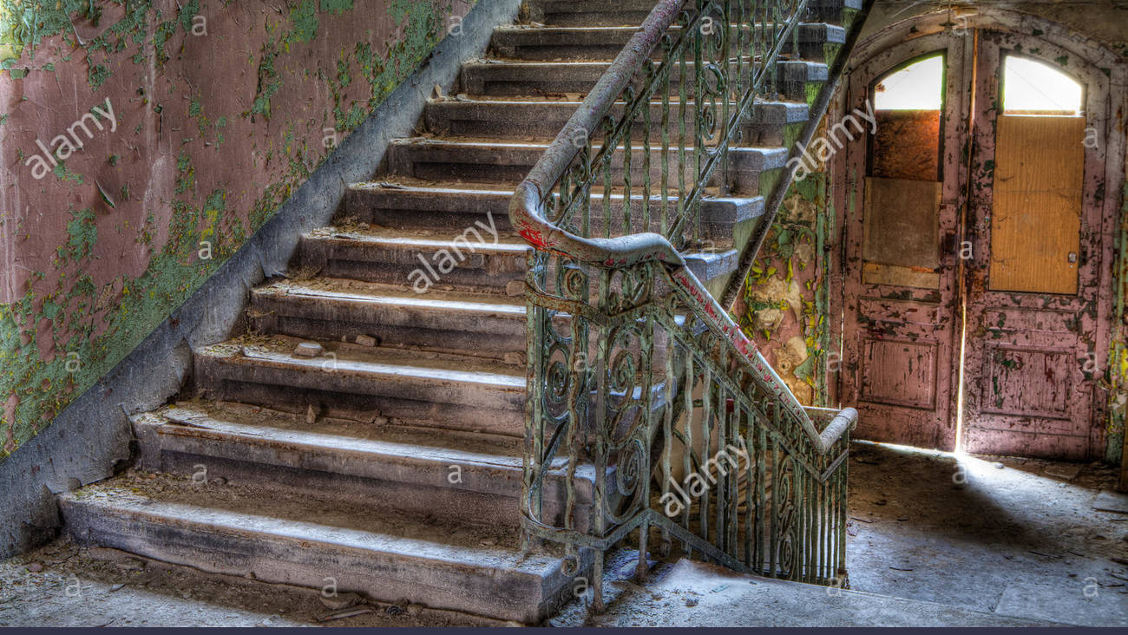
rickety
a rickety flight of stairs

Slide 11
Why do you think the author chose to have this weather and imagery at the very start of this prologue?

Slide 12
What do these two things tell us? The bloodshot eyes widening The use of italics
Individual thinking

Slide 13
Find and copy any words or phrases that suggest ‘the boy’ might be dangerous.
Individual thinking
The door opened with a groan, and they stepped inside. The room was musty and dusty and stank of damp. A ragged crow was perched in a narrow window, its eyes gleaming like black diamonds in Copyright © first year of publication Individual author and/or Walker Books Ltd. All rights reserved. W 10 E the lamplight. Beside the window, another animal nested among a bundle of sacks. No, not an animal. It was a boy. The boy sat very still, staring out of the window. “That him?” the showman asked. Master Bledlow raised his lamp so its light fell on the boy’s back. “See?” he said. And now the showman saw. The boy was covered almost completely in hair. Dark brown hair, matted and tangled with dirt. It grew all over his back, his shoulders and his chest. A darker swathe hung from his head, and a thick layer spread all over his face, smoothed and parted down the middle. It hid the boy’s features completely, apart from two big eyes, big like an owl’s eyes. Startlingly green, they sparkled even in the murky light from the moon. As the boy sat perfectly still, those eyes moved at incredible speed, watching the foggy scene outside.

Slide 14
‘Beside the window, another animal nestled among a bundle of sacks. No, not an animal. It was a boy.’
Why might the showman have mistaken the boy for an animal? Taking everything into account so far, how might the showman have been feeling at this point?

Slide 15
Solo work
Queries and Theories.
You will now have four minutes to write down any questions you would like to ask about what you have read so far.
You will then create your own theory as to why the boy is the way he is.

