Slide 1
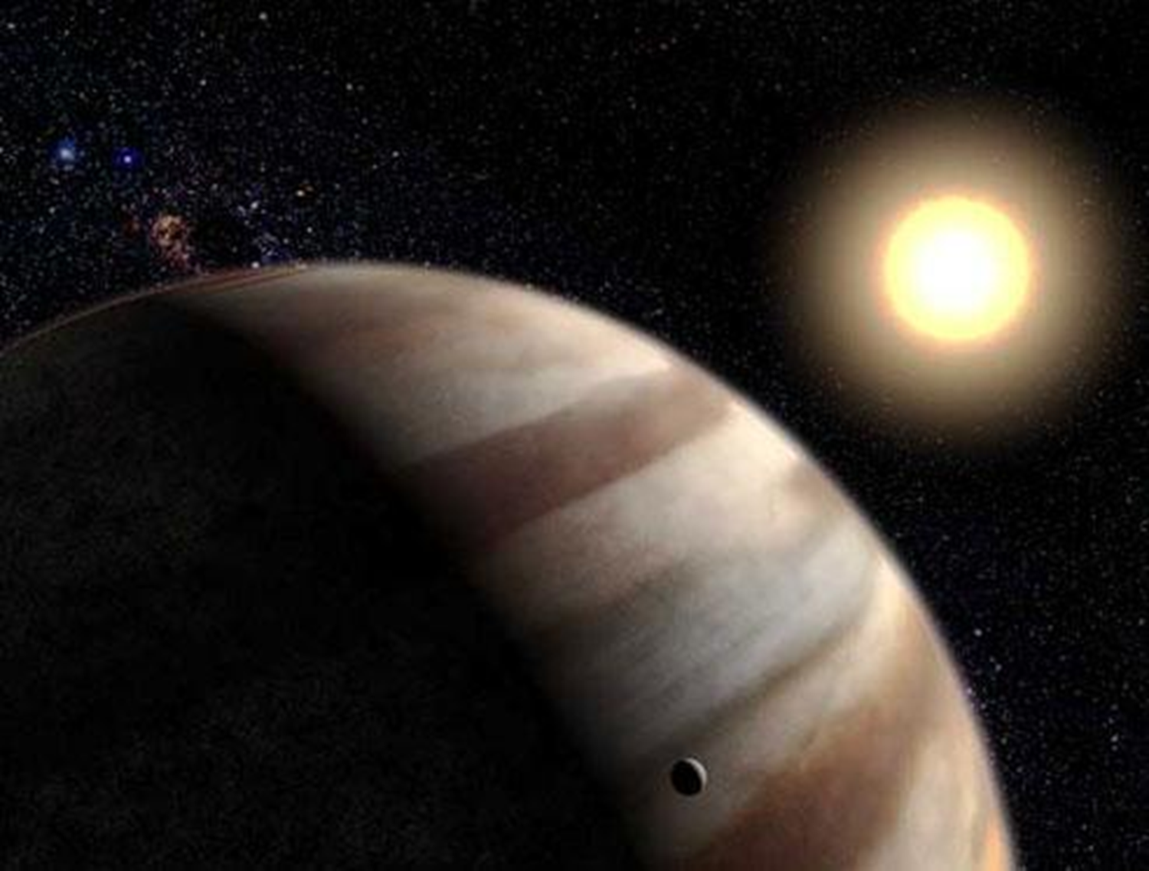
Gustav Holst and The Planets
The Planets Suite
(Week 5)
Gustav Holst
1874 - 1934

Slide 2

Week 5 – Mercury
(Gustav Holst, The Planets Suite)
This week (Week 5), we will listen to ‘Mercury’ from ‘The Planets Suite’ (by Gustav Holst).
Slides 3-13 provide information about the life of Gustav Holst. If you have read this already, go straight to Slide 14.
Slides 14-20 provide information about the ‘Mercury’ movement.

Slide 3
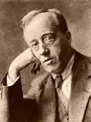
Learning about a famous composer’s life
Gustav Holst was an English composer and music teacher for over 20 years.
Most of the music he composed was original, but he had influences from Hindu spiritualism and English folk tunes.

Slide 4
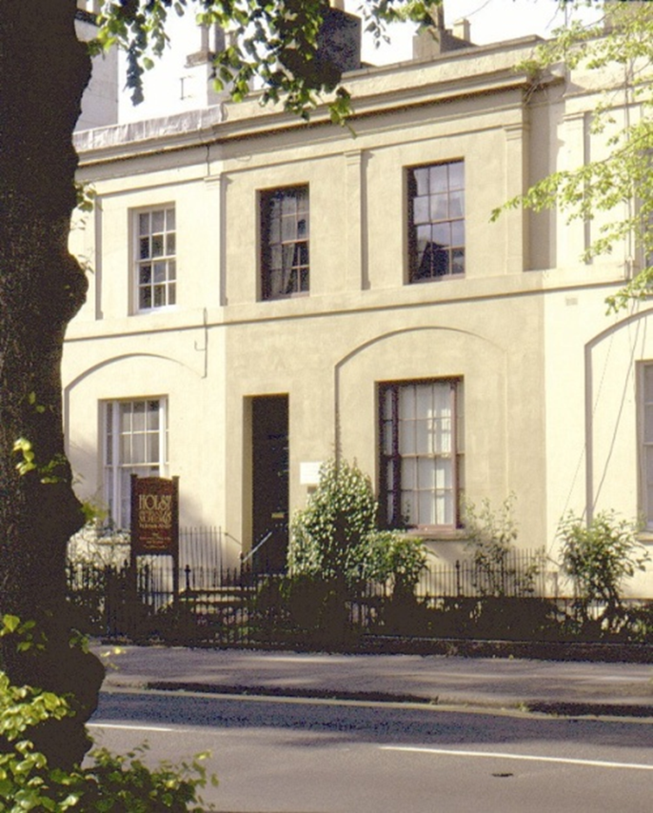
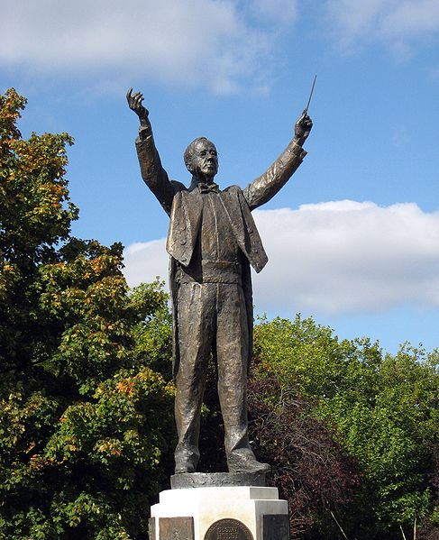

Learning about a famous composer’s life
Gustav Holst was born in Cheltenham, England on the 21st September 1874.
Statue of Holst in his home town.

Slide 5
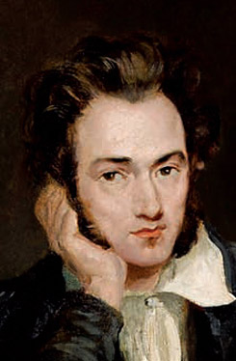
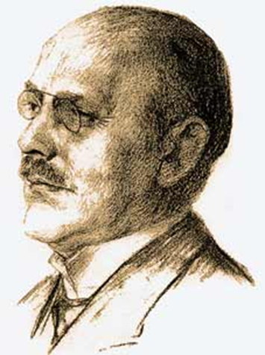
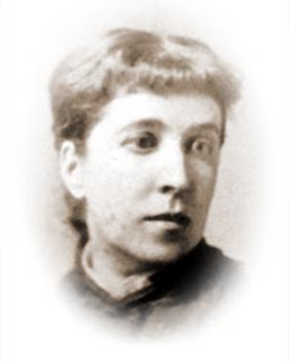
Learning about a famous composer’s life
Holst was born into a very musical family. His grandfather was a harp composer and teacher; his father was an organist, pianist and choirmaster, and his mother was a singer.
Clara Holst
Gustavus von Holst
Adolf Holst

Slide 6
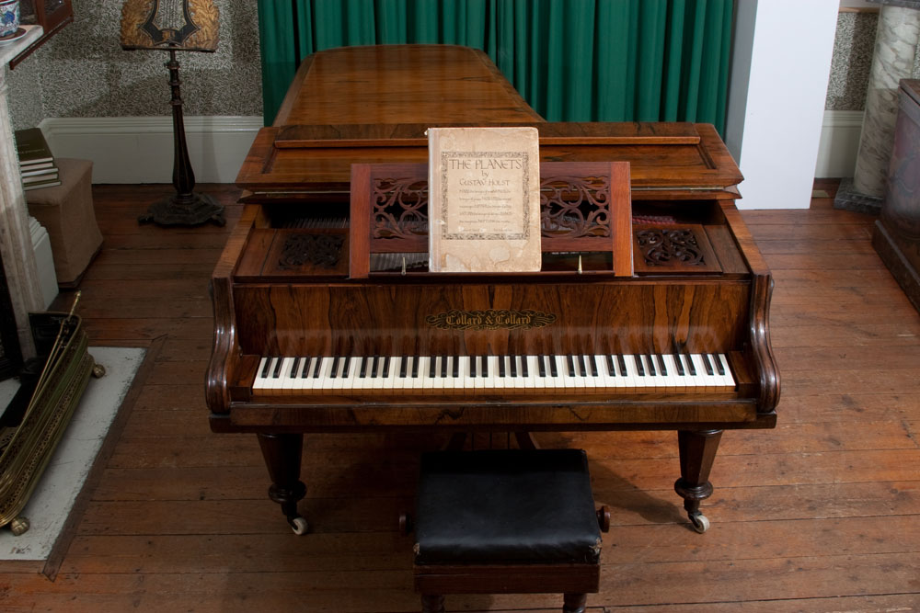
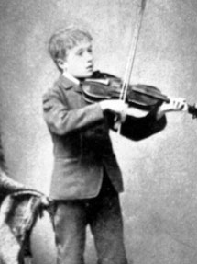
Learning about a famous composer’s life
As a child, Gustav was taught the piano and violin.
This is Holst playing the violin.
This is Holst’s piano. You can see it in the Holst Birthplace Museum. He composed The Planets on this piano.

Slide 7
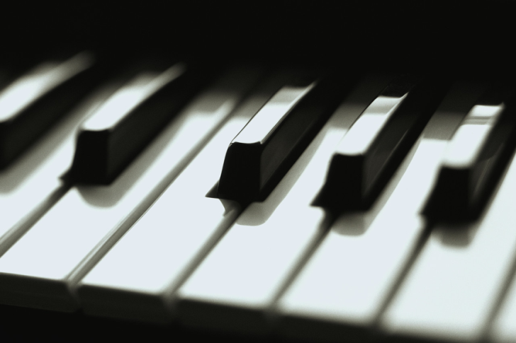
Learning about a famous composer’s life
Gustav was a sickly child. His eyes were weak, but no-one realised that he needed to wear glasses.
His chest was weak and he suffered from asthma.
When he was young, Gustav hated playing the violin, but enjoyed playing the piano.

Slide 8
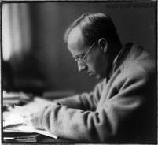
Learning about a famous composer’s life
Unfortunately, Holst also had pain in his hands, so it made practising the piano very difficult and painful.
After leaving school, he got his first job as an organist and choirmaster.

Slide 9
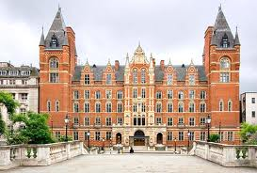
Learning about a famous composer’s life
He became a student at the Royal College of Music, where he studied composition.
Unfortunately, the pain in his right hand became worse. Playing for a long time was impossible and he had to accept that he would never be a professional concert pianist.

Slide 10
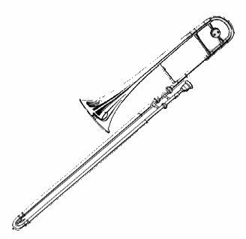
Learning about a famous composer’s life
Holst decided to take up the trombone. It would allow him to play in orchestras, and he could earn some money. Also, the experience would be useful to him as a composer. Perhaps, he also thought that playing the trombone would help to strengthen his chest and lungs.

Slide 11
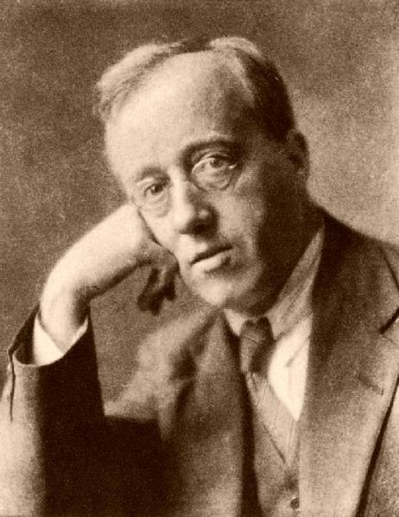
Learning about a famous composer’s life
Holst wrote The Planets Suite between 1914 and 1916.
Each of the seven movements is named after a planet of the Solar System and its corresponding astrological character.

Slide 12
Learning about a famous composer’s life
1. Mars - the Bringer of War
2. Venus - the Bringer of Peace
3. Mercury - the Winged Messenger
4. Jupiter - the Bringer of Jollity
5. Saturn - the Bringer of Old Age
6. Uranus - the Magician
7. Neptune - the Mystic

Slide 13
Learning about a famous composer’s life
Holst did not compose a piece of music about Pluto, as Pluto was not discovered until 1930.
Colin Matthews, a recent composer created a piece of music called Pluto: the Renewer. This is sometimes played alongside Holst’s Planet Suite in concerts. https://www.youtube.com/watch?v=W3Mcn3zo5C0

Slide 14
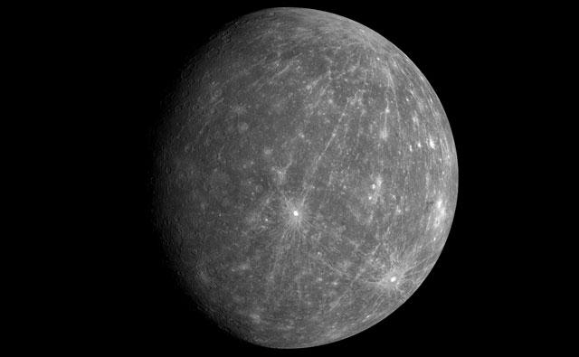
Mercury
The Winged Messenger
(Week 5)

Slide 15
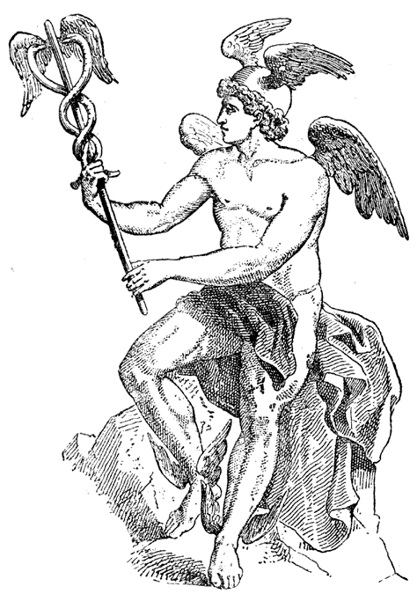
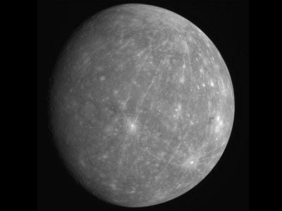
Learning how a woodwind instrument works
Mercury was the messenger-god of Jupiter, the god of games, business and story-telling.

Slide 16
Learning how a woodwind instrument works
Watch video clip: Watch Mercury here
While you listen, draw a picture of how the music makes you feel.
(Later on, if you would like to, use the separate “Recording Sheet” to write about this music in detail.)

Slide 17
Learning how a woodwind instrument works
Mercury, the winged messenger has been described as flitting about, not unlike a cosmic butterfly.
Listen to an extract again:
What instruments can you hear?
How can you tell?

Slide 18

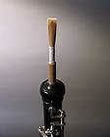
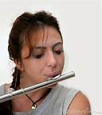
Learning how a woodwind instrument works
Some woodwind instruments are played by vibrating one or two wooden reeds, whereas others are blown directly into the mouthpiece.

Slide 19
Learning how a woodwind instrument works
Mercury consists of mainly woodwind instruments, that pass from one to another.
Woodwind is the section of the orchestra that makes a noise when breath is blown along it. Woodwind instruments are virtually straight, and are made of wood or plastic with some metal.

Slide 20
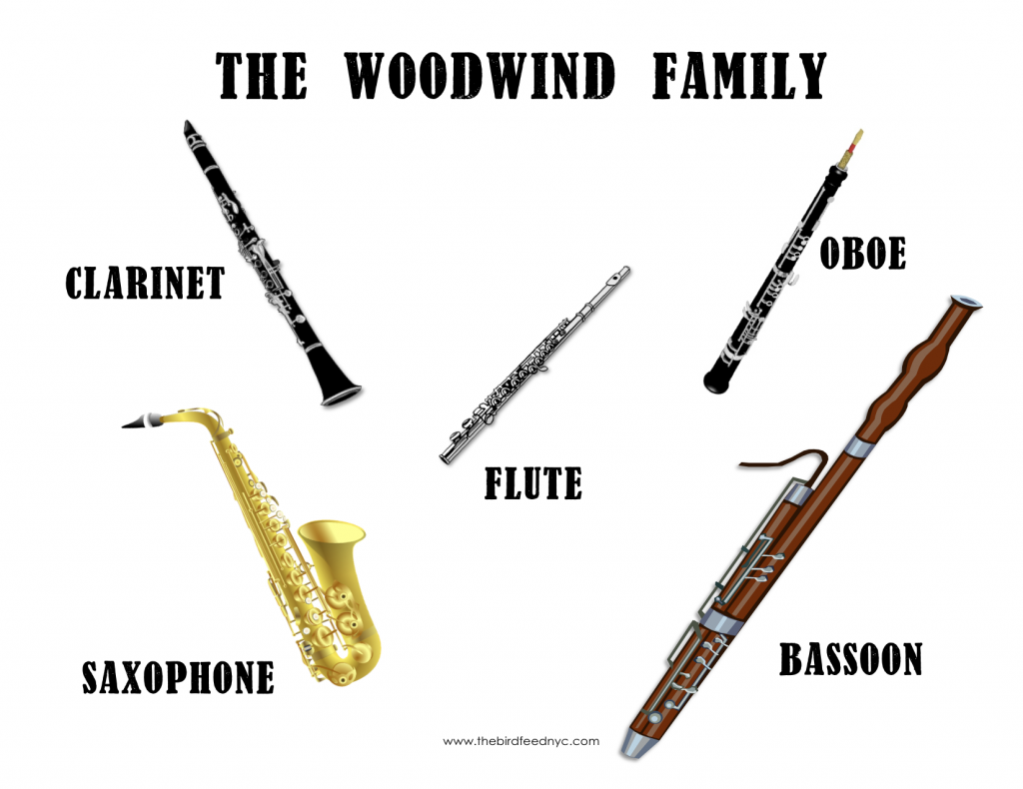
http://datadragon.com/education/instruments/winds.shtml

