Slide 1
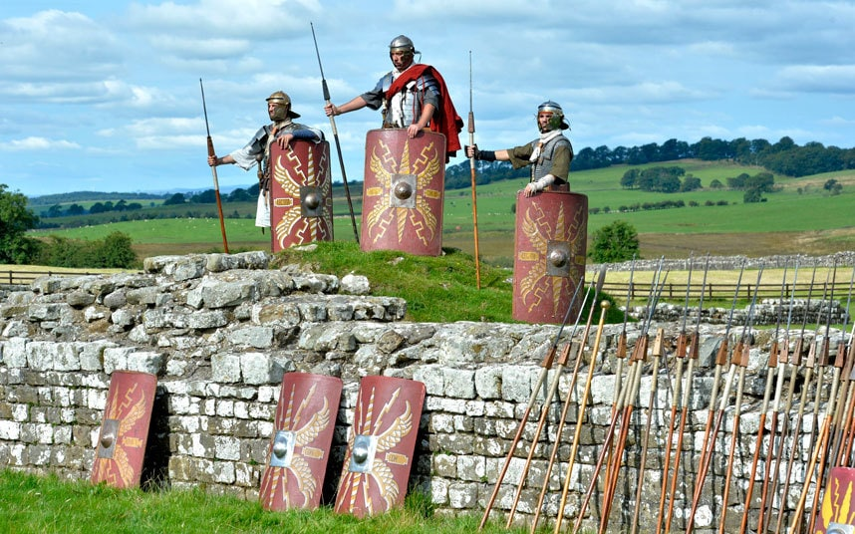
Literacy/Topic Task
Watch the video in the link below about what life was like for the Auxiliary Soldiers guarding Hadrian’s Wall.
Once you have watched it, imagine you are one of the soldiers whose task it is to guard Hadrian’s Wall against Barbarians (local tribes who lived the other side of the wall).
Using information from the video, write a letter home to your family explaining what life was like in Roman Britain. Describe the wall and what it was built for, what your barracks are like and your day-to-day life as a soldier. Feel free to add personal information, like what you miss or would like sent from home or even what you think of the British weather!
Upload your finished letters to the website. We look forward to reading them!
Soldiers Guarding Hadrian’s Wall
https://www.bbc.co.uk/teach/class-clips-video/soldiers-in-roman-britain/z7d9wty

